Slide 1
AI-Integrated Blockchain-Based medicine tracking system
Team Name: BITRONIX
Team Members:
Archana Kedareshwari
Meghana N
Kathyayani N
Geethanjali Polani

Slide 2
IDEA TITLE
Problem Statement
Fake and expired medicines in the supply chain cause serious health risks. Traditional tracking systems lack transparency and are easy to tamper with, making it difficult to verify the authenticity and source of medicines.
Objectives
To develop a secure and transparent system using Blockchain and AI that can track, verify, and ensure the authenticity of medicines throughout the supply chain — from manufacturer to consumer.
Novelty
This project combines Blockchain and AI to track and verify medicines securely. Unlike existing systems that only store data, our system uses AI to detect fake or unusual transactions and lets users verify authenticity through a QR code. It offers a simple, low-cost, and intelligent way to prevent counterfeit medicines.
Proposed solution
Use Blockchain to securely record each stage of a medicine’s journey and AI to detect fake or abnormal transactions. This ensures transparency, authenticity, and safety across the entire medical supply chain.

Slide 3
Manufacturer
Adds medicine details
🏭
Distributor / Wholesaler
Updates shipment & status 🚚
Blockchain Network
Stores all transaction data securely 📦
Pharmacy
Verifies medicine data from blockchain before sale 💊
AI Module
Analyzes blockchain transaction patterns. Flags suspicious or fake activities 🤖
Consumer
Scans QR code📱 Fetches medicine authenticity details from blockchain
Output Display
✅ “Medicine Verified”
⚠ “Fake / Suspicious Medicine Detected”

Slide 4
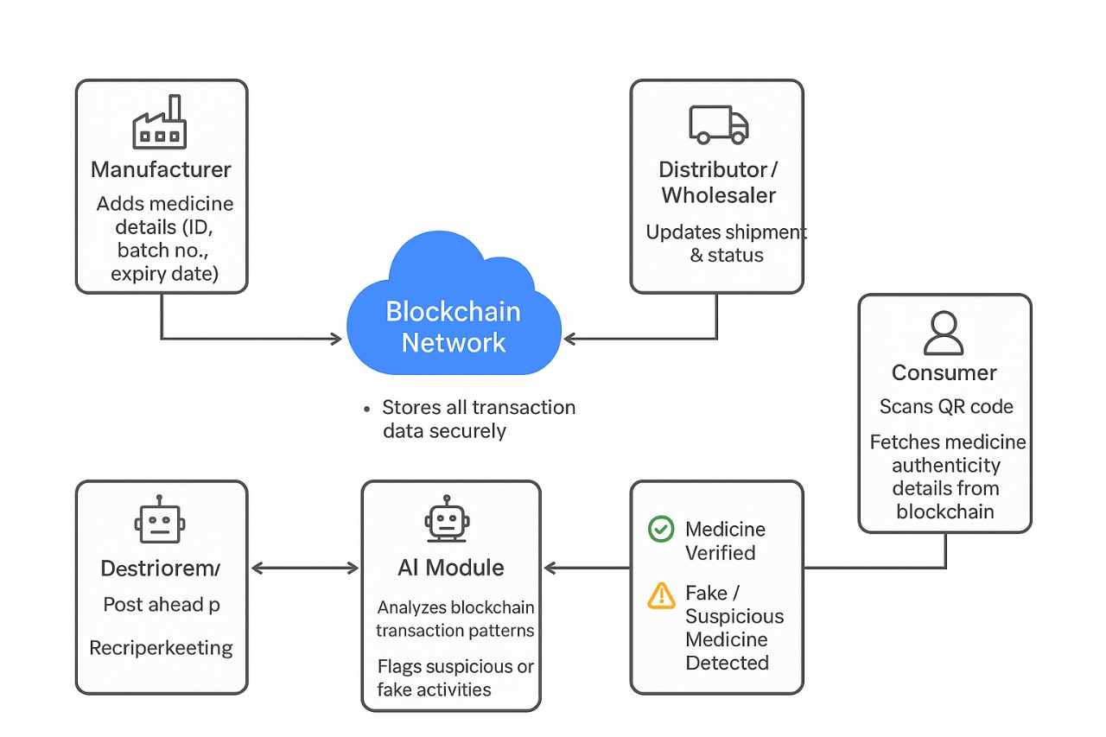
FEASIBILITY AND VIABILITY
Feasibility Analysis
Technical Feasibility: Uses open-source tools like Ethereum, Python, and JavaScript — easy to implement on normal laptops.
Operational Feasibility: Simple interface with QR code and AI verification ensures transparency and user trust.
Economic Feasibility: Low-cost project using free tools and software, suitable for student-level development.

Slide 5
Potential Challenges Integration Issues: Connecting blockchain, AI model, and frontend smoothly may be complex.
Data Accuracy: AI detection depends on quality and quantity of training data.
Scalability: Handling large numbers of transactions on blockchain can be slow or costly.
User Adoption: Encouraging manufacturers and pharmacies to use the system consistently.
Security Risks: Protecting private keys and preventing unauthorized data access.
Strategies to Overcome Challenges
Use modular design to simplify integration of all components
Train AI with verified and diverse datasets
Use test networks or hybrid storage to reduce blockchain load
Implement strong encryption and secure login for data protection
Provide simple UI and awareness to improve user adoption

Slide 6
Technical Approach
A Blockchain-based smart contract records every medicine transaction — from manufacturer to pharmacy — ensuring transparency and traceability.
The frontend (HTML, JS, Web3.js) interacts with the blockchain for adding and verifying medicine details.
An AI module (Python) analyzes transaction data to detect counterfeit or abnormal patterns.
Each medicine gets a unique QR code linked to its blockchain record for easy customer verification.
All modules (Blockchain, AI, Frontend) are integrated to form a secure and intelligent medicine tracking system.

Slide 7
Thank you

